Slide 1

Pennsylvania Senate Race
Faisal Alkhonji

Slide 2
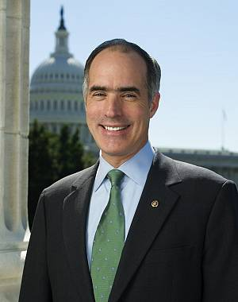
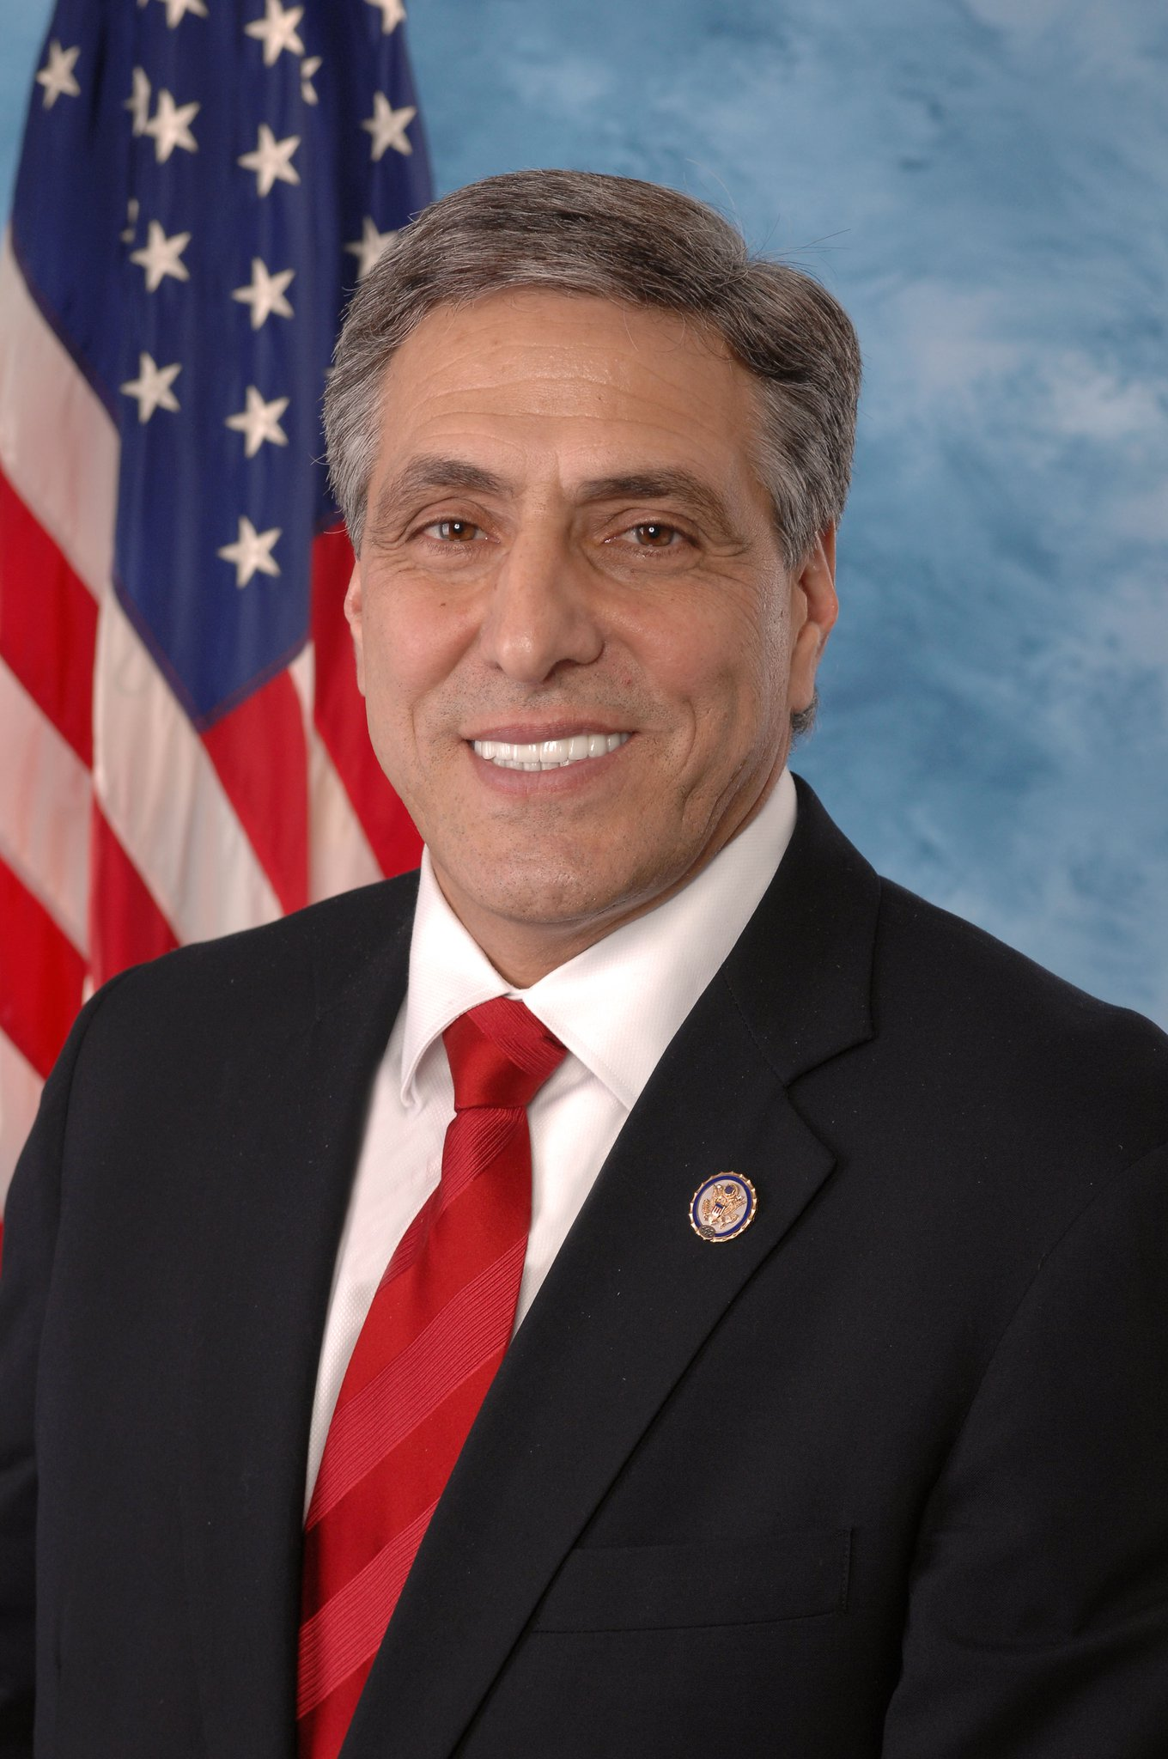
Candidates
Bob Casey Jr. (D)
Lou Barletta (R)

Slide 3
Bob Casey Jr. (D)
Current incumbent
Law degree from Columbus School of Law
Pennsylvania Auditor General (1997-2005)
Pennsylvania Treasurer (2005-2007)
Son of Bob Casey Sr., former Pennsylvania Governor
Ran for Governor in 2002, but got defeated
Defeated two-term republican incumbent Rick Santorum in 2006
Re-elected in 2012 becoming the first democrat to be elected to a full term and the first to win re-election from Pennsylvania since 1962

Slide 4
Lou Barletta (R)
U.S. Representative for Pennsylvania’s 11th congressional district since 2011
Mayor of Hazelton (1999-2010)
In 2004, he was appointed by the White house to serve on the United Nations Advisory Committee of local authorities
Currently serves on three House committees: the House Transportation and Infrastructure Committee, the House Homeland Security Committee, and the House Committee on Education and the Workforce.
Voted Mayor of the year in 2008
Endorsed by Trump

Slide 5
Issues
Bob Casey Jr. (D) | Lou Barletta (R)
Fighting for American workers | Leading the fight against Illegal immigration
Standing up for small businesses | Saving taxpayer money
Protecting and strengthening healthcare | Finding solutions to the opioid crisis
Taking care of seniors | Supports the 2nd Amendment
Protecting Americans with disabilities | Defends Israel and the Jewish community
Safe, quality education at every age | Family-sustained jobs

Slide 6
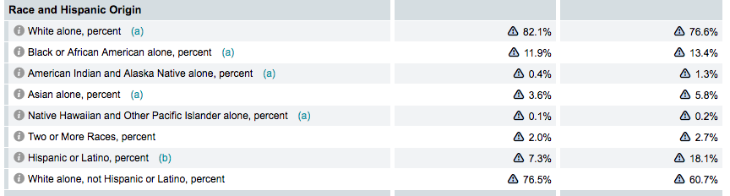
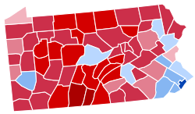
Electorate

Slide 7
Fundraising
Candidate | Raised | Spent | Cash on hand
Bob Casey Jr. (D) | $20.4 million | $13.8 million | $6.7 million
Lou Barletta (R) | $6.1 million | $5.2 million | $1.3 million

Slide 8
Campaign Ads
Bob Casey Jr. (D)
https://www.youtube.com/watch?time_continue=30&v=Fd4tZkiLKG0
Lou Barletta (R)
https://www.youtube.com/watch?v=0eyscuIJIY8

Slide 9
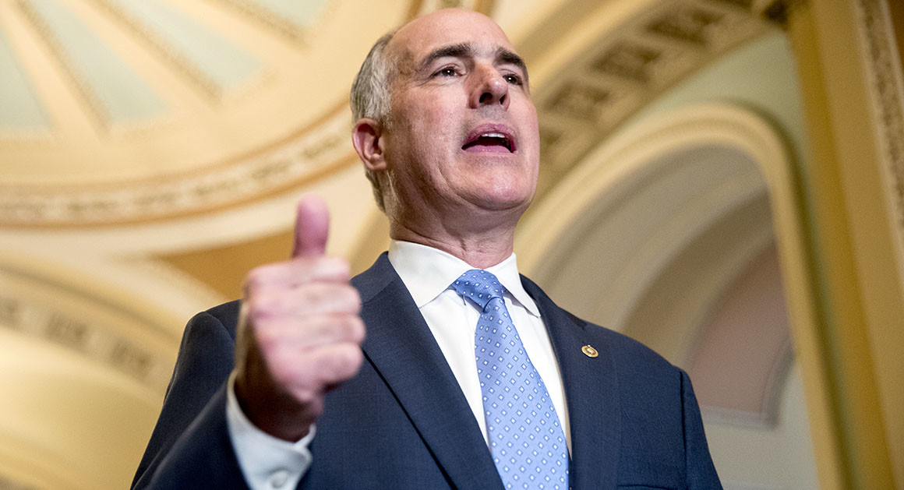
Prediction

